Slide 1
Anthropomorphic Task Analysis for Simulation
John F. Richardson
Spring Simulation Multi-conference
Pasadena, California
April 3, 2016

Slide 2
Anthropomorphism
The attribution of human traits, emotions, and intentions to non-human entities [Wikipedia]
Having human characteristics [Oxford Dictionaries]
Ascribing human characteristics to nonhuman things [Mirriam-Webster]

Slide 3
Goal
The Non-human entities to be discussed
Virtual Environments
Human Factors
Extraordinarily Complex Simulations

Slide 4
Virtual Environments
Spring Sim Conference Venue
This is an infinitesimal subset of the DOMAIN of SIMULATION
TASKS
NUMERICS
BIM
LABVIEW
MATLAB
MEMETIC
DAQ
DAQ
SIMULINK
TASKS
MAYA / BLENDER / X3DEdit / Adobe / HOUDINI
Symbolic Algebraic Manipulation
TASKS
Mathematica System Modeler
MapleSim
SIMULINK 3D ANIMATION
DAQ
Notes:
VE’s are the Black Boxes that it all lives in.
Why Memitic. Well, start with a physics model…most likely leads to a system of PDE’s. How do you discretize the model and retain the Physics. Memetic Methods. Dr. Castillo’s book [Computational Science Research Center at San Diego State University].
I left off all the biochemistry

Slide 5
LIVING IN A VIRTUAL ENVIRONMENT
Now that you have the models, PDE’s, CUDA clusters, Symbolics and Sensors
What ARE The RULES
HOW Complex are the RULES

Slide 6
Did I mention Extraordinarily Complex
How do we discretize bigger and bigger and bigger Virtual Environments
Remember-There are lots of simple subcomponents that can be discretized using well known standard tactics, techniques and procedures
Geometry for Visualization
Geometry for Sensor input
Task mapping for Geometry

Slide 7
Geometry for Visualization
2-D
3-D
Computational Grids
Web3D
DIS and Web3D

Slide 8
Fast Detour
2-D and 3-D

Slide 9
2-D
Not every simulation requires world class Hollywood special effects
Image processing simulations
Photoshop will do, Maple/ Mathematica / Laabview / MATLAB’s 2-D display capabilities, Illustrator, Painter
Slices of 3-D simulation results
Volume rendering [Production Volume Rendering:Design and Implementation [Wrenninge, 2013]]
Abstract Art
Fractals displayed in Toon-Boom Studio
Simulations in Higher dimensional Domains
Zbrush

Slide 10
3-D visualization of results
Mesh Input to your simulation (3-D modelers)
Construction of Virtual Environment
3-D Modelers / X3D Authoring
Output of the simulation
Scenegraph’s [open source / commercial]
VRML / X3D OpenScenegraph
Collada Inventor [commercial]
Game Engines [OGRE, UNREAL,…]

Slide 11
General Tools
Open Source
Need tool that is almost equal to commercial
Has a Community
Under Configuration Management
SVN, GITHUB, DOXYGEN, Has volunteers that will test thoroughly
The right type of license
Is the right type of tool
Blender / X3D / Physics engine [Eberly, 2004]
Has a public reference implementation
Multiple file formats

Slide 12
Mesh Input
Anything from text files to sophisticated data structures
Techniques designed for solvers
Need to be useful [discussed later]
Fundamentals of Grid Generation [Steinberg and Knupp, 1993]
Techniques for 3-D modeling and visualization
Polygon Mesh Processing Botsch, Kobbelt, Pauly, Alliez, Levy, 2010] - Nice Section on Numerics and great Bibliography

Slide 13
Hollywood Meshes
Surfaces
Differential Geometry / Data structures
Make a Grid [You don’t really compute on the grid, it just has to look good]
Have to triangularize the grid
Voronoi diagrams/ Delaunay Triangulations
Make it simpler
Repair it
Have to deform it [cloth, hair, collision]
These are all simulations [focused domain]

Slide 14
Resources / References
2-D
SIGGRAPH Proceedings (Courses) / Eurographics Proceedings (especially STAR’s) [Also 3-D]
Open Source
NIH Image, anything GNU
Adobe Illustrator How-To [Karlins, 2009]
Adobe Illustrator Scripting with Visual Basic and AppleScript [Wilde, 2003]
Compiled AppleScripts can be voice activated
More on this with “Fun with GUI’s” discussion

Slide 15
Resources / References
3-D
Blender website [Rolls Royce of Open Source 3-D modelers and some video production tools]
SIGGRAPH Proceedings (Courses) / Eurographics Proceedings (especially STAR’s)
OpenScenegraph 3.0 Beginners Guide Cookbook [Wang, Qian, 2010]
OpenScenegraph 3.0 Cookbook [Wang, Qian, 2012]

Slide 16
General CG References
Basic
OpenGL SuperBible, 2nd Edition [Wright, Sweet, 2000]
Khronos Group [keeper of the OpenGL and related specifications (WebGL) - www.khronos.org]
Also OpenCL / WebCL
I.E. - HTML5 Distribuled Simulations [M&S community DIS / HLA]
The NURBS Book [Piegl, Tiller, 1997]

Slide 17
More CG References
Mathematics for 3D Game Programing [Lengyel, 2002 - also games]
Graphics Gems Series
Youtube
Games
Game Programming Gems Series [Editor, Kim Pallister] / Game Engine Gems [Editor Lengyel, 2011
3D Game Engine Design: A Practical Approach to Real-Time Computer Graphics [Eberly, 2000]
GPU Programming Gems Series
NVIDIA Website [CUDA simulations]

Slide 18
Even More CG References
Miscellaneous
Production Volume Rendering:Design and Implementation [Wrenninge, 2013]
Visualizing Quaternions [Hanson, 2006]
Computer Animation: Algorithms and Techniques [Parent, 2002]
Poser 7 / 8 / 2014 Manual
Daz Studio Manual
Maya User’s Guide
Softimage User Guide
Houdini User Manual

Slide 19
Two problems with Visualization
People are lazy
They let others control their simulation data exchange [task interoperability]
The File format problem
VE’s have to be rendered
Standards for simulation data exchange [state and task information]
Does FACEBOOK [ ] use DIS or HLA?
FACEBOOK and GOOGLE and Apple and Samsung want to CONTROL your Task Analysis

Slide 20
DIS and Web3D
DIS / VRML / X3D / HLA
Naval Postgraduate School
Start at Web3D Consortium main site and search for DIS and HLA
Open Source with no restrictions
Or you can deal with a standard DIS / HLA FOM and RTI

Slide 21
Virtual Environments
Spring Sim Conference Venue
This is an infinitesimal subset of the DOMAIN of SIMULATION
TASKS
NUMERICS
BIM
LABVIEW
MATLAB
MEMETIC
DAQ
DAQ
SIMULINK
TASKS
MAYA / BLENDER / X3DEdit / Adobe / HOUDINI
Symbolic Algebraic Manipulation
TASKS
Mathematica System Modeler
MapleSim
SIMULINK 3D ANIMATION
DAQ
Notes:
VE’s are the Black Boxes that it all lives in.
Why Memitic. Well, start with a physics model…most likely leads to a system of PDE’s. How do you discretize the model and retain the Physics. Memetic Methods. Dr. Castillo’s book [Computational Science Research Center at San Diego State University].
I left off all the biochemistry

Slide 22
Comments on Complexity
Creating Agent Teams is NP-Hard
Okimoto, Schwind, Clement, Inoue,Marquis; How to Form a Task-Oriented
Robust Team, Proceedings of the 14th International Conference on Autonomous
Agents and Multiagent Systems (AAMAS 2015)
That is not Good
Now there are nice results on DEVS reachability
M.H. Hwang and B.P. Zeigler, Reachability Graph of Finite and Deterministic DEVS Networks ; IEEE Transactions on Automation Science and Engineering, Volume 6, Issue 3, 2009, pp. 454–467

Slide 23
Little Bit more Complexity
Recent work
Rational time advance and model correctness
Wainer, Saadawi “ Principles of Discrete Event System Specification model verification”, Transactions of the Society of Modeling and Simulation International 89(1) 41-67
Irrational Time advance and model correctness
Monday, 4 April 2016
Session TMS 1A 1030 – 1200 Room: Santa Rosa Chair: Hans Vangheluwe
An Advanced Data Type with Irrational Numbers to Implement Time in DEVS Simulator (Damián Vicino, Olivier Dalle and Gabriel Wainer)

Slide 24
General Sim References
Bernard Zeigler (1976). Theory of Modeling and Simulation (first ed.). Wiley Interscience, New York.
Gabriel A. Wainer (2009). Discrete-Event Modeling and Simulation: A Practitioner's Approach (first ed.). CRC Press.
Gabriel A. Wainer and Pieter Mosterman Eds. (2010). Discrete-Event Modeling and Simulation: Theory and Applications (first ed.). CRC Press.
Saurabh Mittal and Jose L. Risco Martin (2013). Netcentric System of Systems Engineering with DEVS Unified Process (first ed.). CRC Press.

Slide 25
Task Type Detour (Philosophical Anthropomorphic Categories)
Deterministic and Isolated [special purpose]
Non-Deterministic and Isolated [special purpose but lots of management overhead]
Deterministic and Distributed [Simulation Markup Languages / Custom since later on discussion of Task Characteristics / Goals]
Non-Deterministic and Distributed [interoperability and complex task management for Task data distribution]

Slide 26
Geometry for Sensor Input for Tasks
Naturally, tasks don’t have to have ties to geometry
Simple tasks for agent simulations
Helper sub tasks and helper sub-behaviors [discussed later]
However, a parent task or behavior may benefit from geometry

Slide 27
Why do we need Human Factors and Task Analysis (some comments)
Simulations are very complex
Virtual Reality People
Geometry [Keyframe animations]
With task helpers
Can be associated with Agents
IoT simulations
Training for human interaction
AI [agents with attached tasks]

Slide 28
Task Management for Geometry
Task domains
Task Level of Detail
Simulation Level of Detail
Task Mapping to Level of Detail
Map Task LOD and Sim LOD to Geometric LOD

Slide 29
Human Factors Introduction
Task Characteristics + Hierarchical Simulations
Similar to Task Goals from Human Factors perspective.
Tasks designed for simulation interoperability
Data
Simulations are part of the task
Task pools / Simulation pools
Build up hierarchies from the pools

Slide 30
Task Analysis
Task Characteristics
Task Goals
Hybrid
Task Characteristics and Task Goals
Are equivalent for Task Analysis
I fold in Goals to facilitate hierarchical and sequences analysis especially for interoperability

Slide 31
Task Characteristics
Lets talk about simulation behaviors
Described by behavior types similar to Task Types
Simulation behaviors live in a “black box”
Specific problem domain or general problem domain
Hierarchical problem domain or distributed problem domain
As simulation behaviors become interactive and/or more complex then interoperability issues occur
With or without VE’s, sensors (DAQ / speech / goggles / IoT)
Tactics, techniques and procedures for Simulation modeling and execution in one problem domain can complicate interoperability or even worse, interfere with interoperability
Notes:
AMF versus STL example in Computer Graphics.
Cyberphysical (IoT) vs theoretical
Labview paradigm versus CAS paradigms vs Simulation tools
Comments fro Stack exchange
You can't really compare SystemModeler and Simulink because the latter is based on transfer-function models and SystemModeler uses the object oriented modeling- language Modelica. Sure you can simulate a lot of systems in both packages, but the process of doing so is nothing alike. Furthermore Modelica is suitable to simulate multidomain problems (including e.g. thermal systems).
@Sascha - its a good point. However, Wolfram themselves compare SystemModeler with Simulink wolfram.com/system-modeler/modeling-tools-comparison/… – WalkingRandomly
@WalkingRandomly - and no one can blame them doing so, since object based modeling turns out becoming more and more popular in a lot use cases. However, I would not suggest it to someone really comfortable with Simulink, especially not when working with e.g. signal-proceccing, control theory or the like. (While the capabilities of Mathematica in both mentioned fields are rather nice indeed - Version 9 looks even more promising with build-in functions like PIDTune)
3 I've heard of SystemModeler, but didn't have time to download a demo and play with it. For me (and others, I think) this answer could be improved a lot by showing one or more simple problems and how they would be tackled with Simulink and SystemModeler.
From the user perspective the conceptual difference between Simulink and SystemModeler is how the analyzed system is described. SystemModeler (WSM) works at the component level while Simulink works at the "block diagram level". This means that the user defines how the components are connected and WSM is responsible for the development and solution of the equations. With Simulink one needs to provide the behavioral description (transfer functions) of each block and the system.

Slide 32
More Task Characteristics
Characteristics of Task / Behavior
Coupling to other behaviors and task / behavior sequences
Coupling management
Goals and Goals coupling
Failure management
Input / Output
DAQ / State (management) / anthropomorphic [beep, beep,… flash your goggles, play punk rock music,…]
Notes:
An old fart like me…started from MUD’s, MOO’s and board games. Strength = 10 ; energy = 5…☺

Slide 33
Characteristics of Task / Behavior
Suppose it is an Arduino Board
Electrical characteristics
Suppose it is a Drone
Lift and drag coefficients
Navier-Stokes model
Memetic or FEM discretization
Suppose it is a MathML object
Category of equation
Human Task [turn on light, operate lever]
Training versus non-training

Slide 34
More characteristics
Identification of algorithms, system equations, states
Data I/O, Speed,…
Virtual Environments
LOD (Level of Detail more polygons when zoomed in… Less polygons when zoomed out)

Slide 35
Interoperability Characteristics
Subtasks / behavior prerequisites / SLOD
Parent task / behavior association / SLOD
Fixed list
Publish and Subscribe
Development Time note: Command and Control system for fire control took 5-10 years
“Helper” behaviors
Atomic or complex
Focused
Libraries of hopefully interoperable “Helpers”

Slide 36
Helper Behaviors detour
How complex should helpers be
Memetic toolkit solvers
CAS solvers
SIMULINK / SYSTEM Modeler
SCADA / IoT Virtual Instruments [Labview VI’s]
Real time VI’s
Virtual Instruments
COMSOL MultiPhysics
MATLAB Numerics [Example: Signal Processing toolkit]

Slide 37
Goals and Failure Management
How do you tell if your Task accomplished it’s goal?
Experimental Observation
Sample size
Statistical Evaluation
Ethics [Goal is to be aggressive]
[“Are Aggressive Agents as Scary as Aggressive Humans”, Blankendaal et al, Proceedings of the 14th International Conference on Autonomous Agents and Multiagent Systems (AAMAS 2015)]
Normal Failure criteria plus criteria for subtasks / sub-behaviors]
What if your task / behavior can inject bad states or data [Anthropomorphic = lying]
“Evil” is “Live” backwards….☺

Slide 38
“Evil” is “Live” backwards….☺
Agent / (task / behavior) activities with cost factor
Pujol-Gonzalez,Cerquides, Farinelli, Meseguer,Rodriguez-Aguilar Efficient Inter-Team Task Allocation in RoboCup Rescue; Proceedings of the 14th International Conference on Autonomous Agents and Multiagent Systems (AAMAS 2015)
Add workload as a task characteristic
Cooperative games with payout factor
I suspect that nobody has ever determined a realistic payout
Trust factor / behavioral risks
Blankendaal, Bosse, Gerritsen, de Jong, de Man, Are Aggressive Agents as Scary as Aggressive Humans?; Proceedings of the 14th International Conference on Autonomous Agents and Multiagent Systems (AAMAS 2015)
How do you construct parameters

Slide 39
Anthro Characteristics Note
I store the characteristics inside of GUI’s
I.E., the database tables are GUI’s
Supercard UI’s and Pigeon English
Richardson “VRML Based Behavior Database Editor”, Proceedings of Virtual Worlds 98
Or the database tables are dataflow icons.
Perhaps, Simulink blocks
Virtual Instruments [IoT]

Slide 40
MOVEON.SIM
Just declare that your Simulation Universe is Human and treat it like a human.
LOTS of ways of course
This discussion focuses on Tasks…
In particular, Task Characteristics with some Task Goals as the Analysis types…

Slide 41
How I do It
WORK IN PROGRESS

Slide 42
Here is How I Discretize Anthropomorphism
My SIM’s are my friends
So I already meet the definition
Next I need Anthropomorphic programming paradigms
Well, why not program in Pigeon English
Great, I’ll use AppleScript, SuperCard, Automator and ..
While I’m at it, Lets throw in Parallel Dataflow Programming
Labview – Oh wait G is the language of DAQ and IOT Anthropomorphism.

Slide 43
A little bit more HOW
How about some Task Helpers
Symbolic Algebraic Manipulation – That’s Anthropomorphic
Mathematica
Maple
SAGE [just to add open source]
MATLAB
They all have associated simulation systems
No SAGEsim [oh well ..☹]
Simulink 3D Animation / X3D Edit / VRML
Apologies to Labview, and the CAS’s but this is the best Anthropomorphic VE helper

Slide 44
Even more HOW
Task Helpers might need voice control
No idea for Anthropomorphic “gestures” but there were some nice gear at SIGGRAPH [Oculus / thumb ring controller]
So TBD
Speech Recognition and AppleScript
Dragon Dictate [Naturally Speaking]better and can be used with AppleScript
What is a good way to Anthropomorphically control MATLAB and the CAS’s
Detour “Fun with Simulation and CAS GUI’s”

Slide 45
Virtual Environments
Spring Sim Conference Venue
This is an infinitesimal subset of the DOMAIN of SIMULATION
TASKS
NUMERICS
BIM
LABVIEW
MATLAB
MEMETIC
DAQ
DAQ
SIMULINK
TASKS
MAYA / BLENDER / X3DEdit / Adobe / HOUDINI
Symbolic Algebraic Manipulation
TASKS
Mathematica System Modeler
MapleSim
SIMULINK 3D ANIMATION
DAQ
Notes:
VE’s are the Black Boxes that it all lives in.
Why Memitic. Well, start with a physics model…most likely leads to a system of PDE’s. How do you discretize the model and retain the Physics. Memetic Methods. Dr. Castillo’s book [Computational Science Research Center at San Diego State University].
I left off all the biochemistry

Slide 46
Fun with Simulation and CAS GUI’s
So, Have an Anthropomorphic Task sequence with Goals and lots of management
You have lots to choose from
API’s help [DEVS, Agents systems, Memetic solvers]
Roll your own
Open source with GUI’s [Blender / X3D Edit /…] or Open source with “Hello World GUI’s [SAGE]”
MAPLE, MATLAB, Mathematica, Labview

Slide 47
Lets have fun with the MAPLE, SIMULINK and MATLAB GUI’s
Need a way to circumvent the API or substitute for an API…
Applescript
Open Scripting Architecture
PreFAB’s UI Browser
What can you not do
Example: OpenGL, OpenInventor, Mess with Direct3D,…]
For my work, it helps to be a Cocoa / Swift Application
SAGE web services are tough.
Python integration a WIP for Applescript

Slide 48
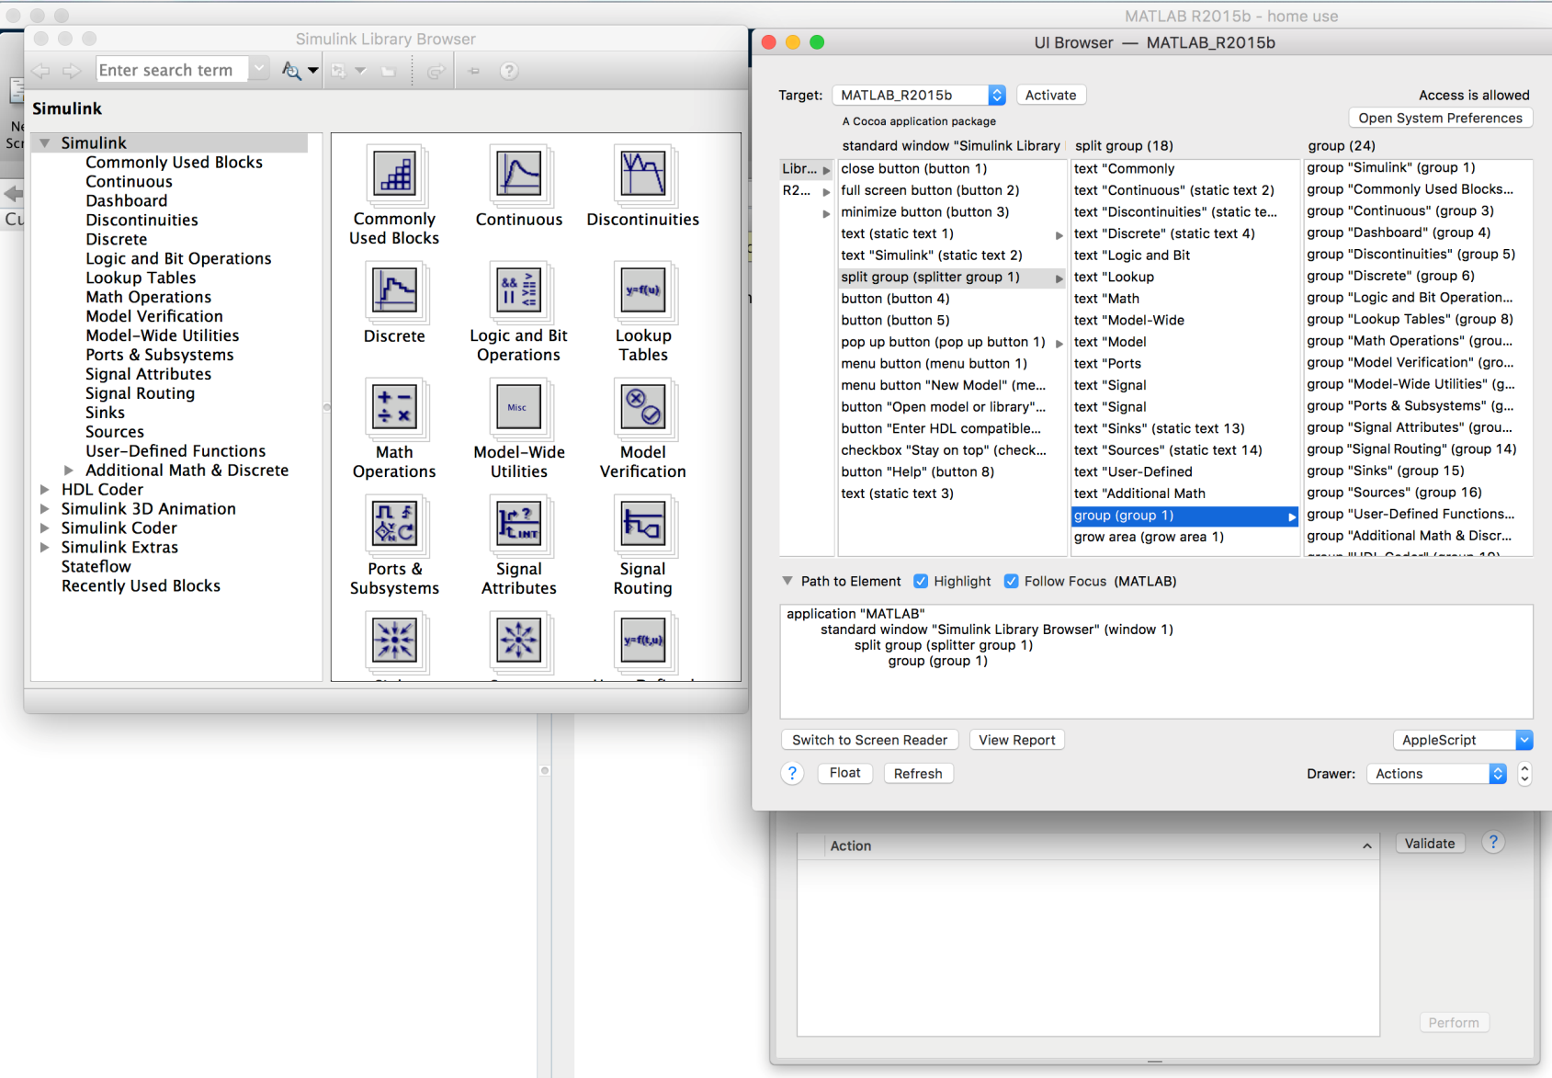
Let’s SNEEK-A-PEEK at SIMULINK

Slide 49
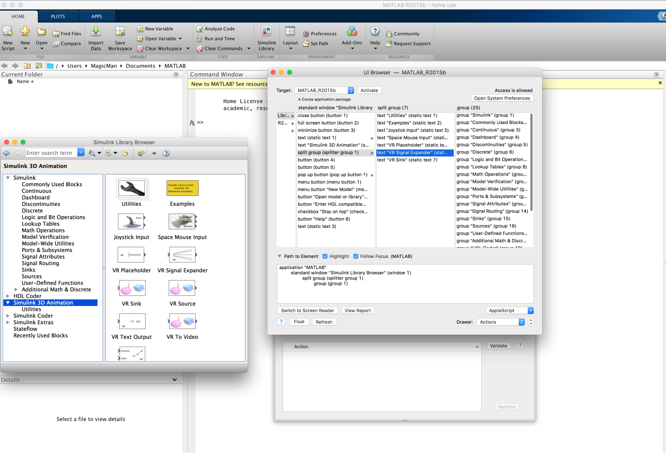
SIMULINK VIRTUAL PEEK

Slide 50
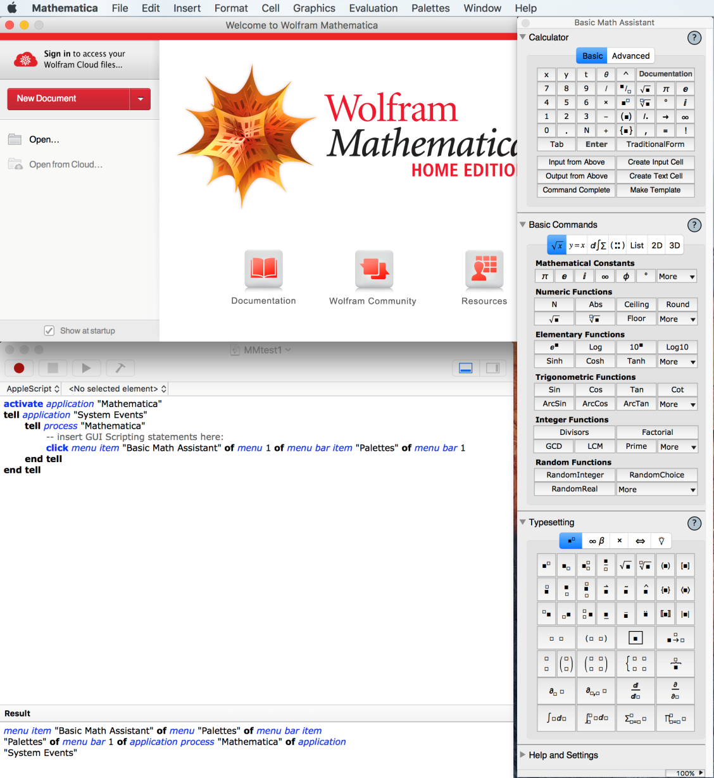
Mathematica Snooping

Slide 51
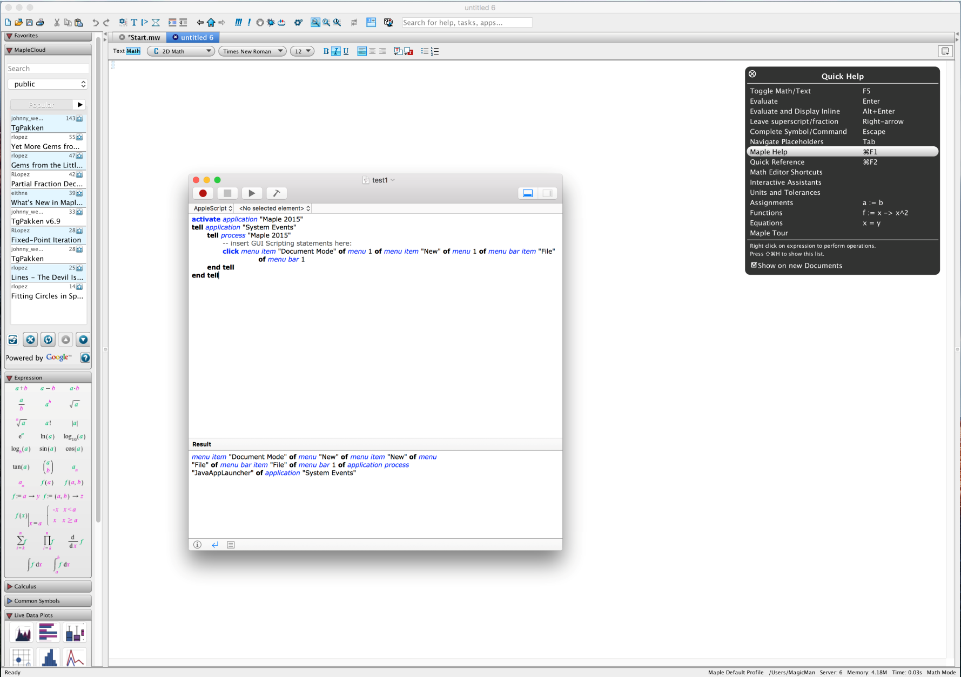
MAPLE SYRUP SECRET RECIPE

Slide 52
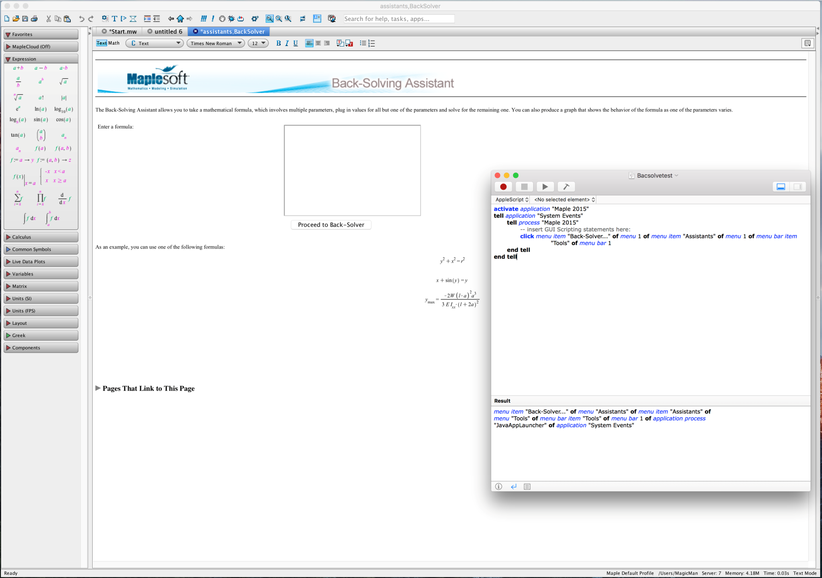
BACK SOLVE MAPLE SYRUP DRIP

Slide 53
What Next
Compile the sneaky scripts
Use Dragon Dictate or Built in voice control
Talk to your Sim’s
Notes:
There are a lot of GUI elements that have very useless scripting references
Explosion of possible behavior task automations
Limited to small anthromophic behavior helpers
Symbolic Algebraic Manipulation / Simulation Metamathematics

Slide 54
Web3D Anthropomorphism
OpenScenegraph
OpenCL / CUDA
GPGPU’s
X3D / VRML97
Let’s start with a simple anthropomorphic Web3D issue
WHY: Anthrpomorphic node spec for Humans in progress for at least 5 years.

Slide 55
Anthropomorphic Navigation
What Navigation Paradigms to use to navigate X3D/VRML VE’s
Goal Driven
Walk, Fly, Examine, Some sort of Reset
Look AT, Pan, Slide, Game [Instant Player from Frauhnhofer IDG]
Characteristic Driven
Anthropomorphic Cartesian [SimVRML (My homegrown viewer) [Y-is UP dot com]
Look Up (around x-axis) / Tilt Left (around z-axis)
Richardson, “Testing the WEB3D Content Creation Pipeline: A Case Study”, SCSC’10

Slide 56
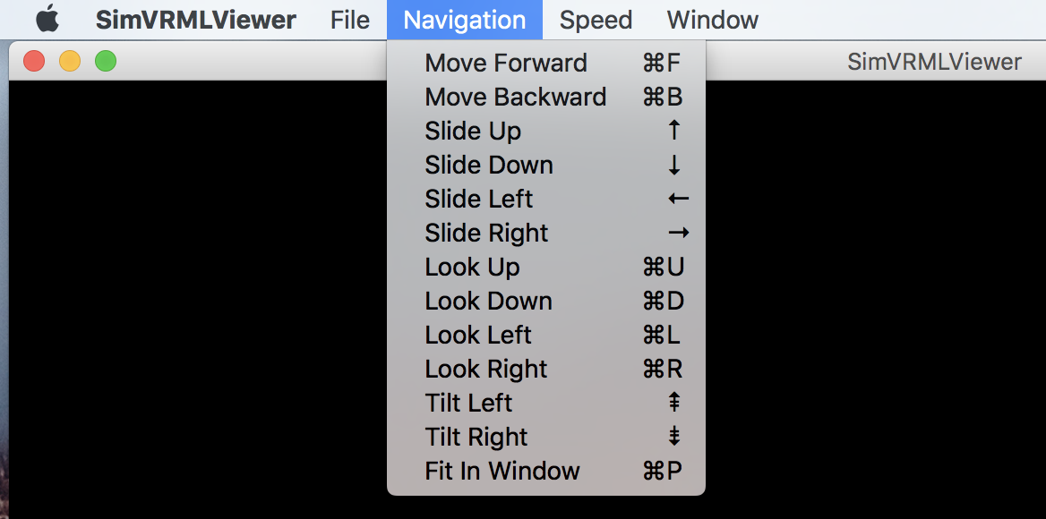
Examples

Slide 57
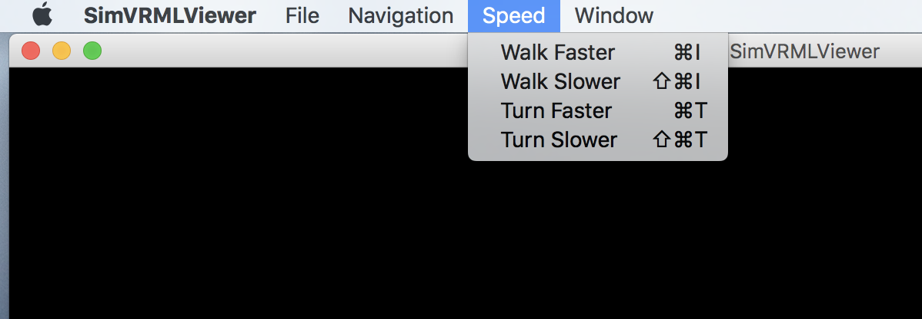
More

Slide 58
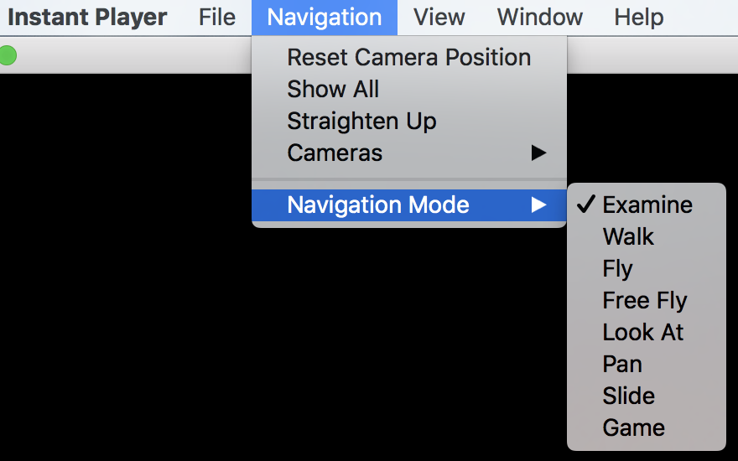
More

Slide 59
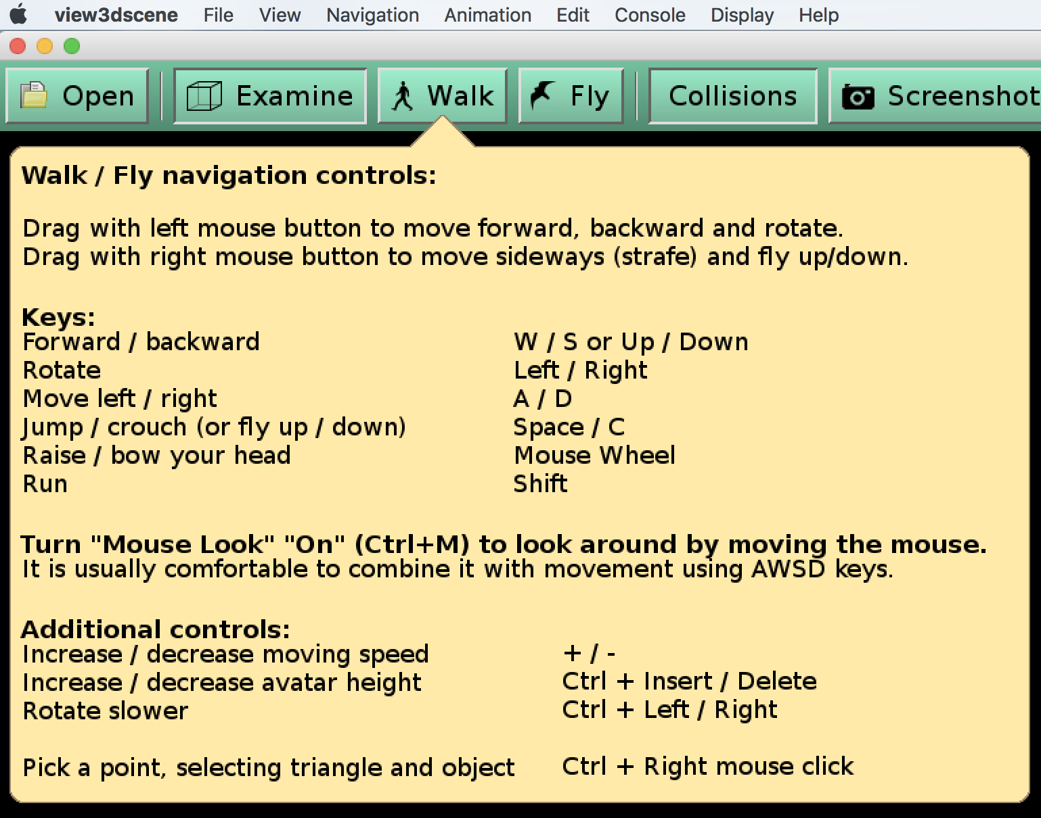
MORE [my favorite 4 letter word]

Slide 60
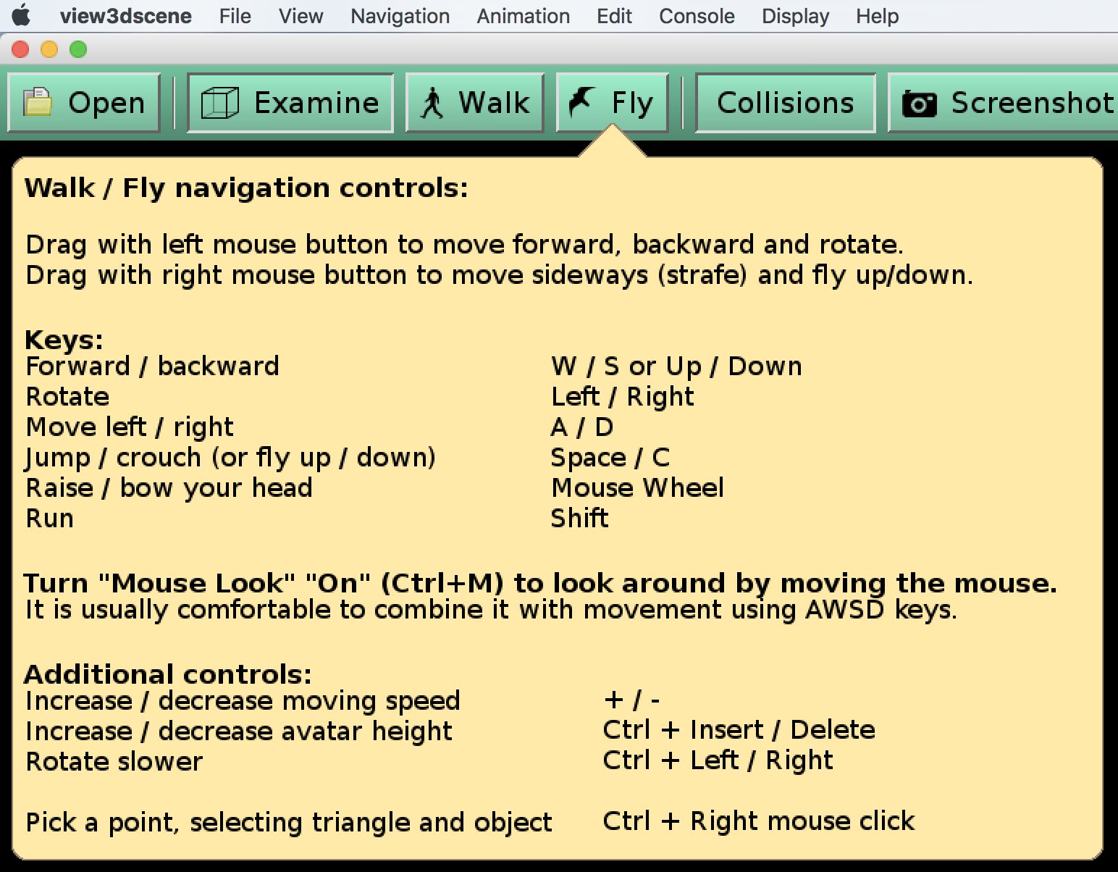
Maybe some more

Slide 61
Anthropomorphism must be planned across Simulation community domains
VE’s are created using tools
Simulations are created using tools
VE I/O structures need to be anthropomorphic
Simulation tools have to discover VE I/O
VE’s have to discover Simulation I/O
Problems
VE nodes may not be anthropomorphic
Simulation structures may not be anthropomorphic
Collaboration needed at community domain boundaries [I.E. – CAS, Simulink,… users and numerical solver libraries and Graphics Geeks]

Slide 62
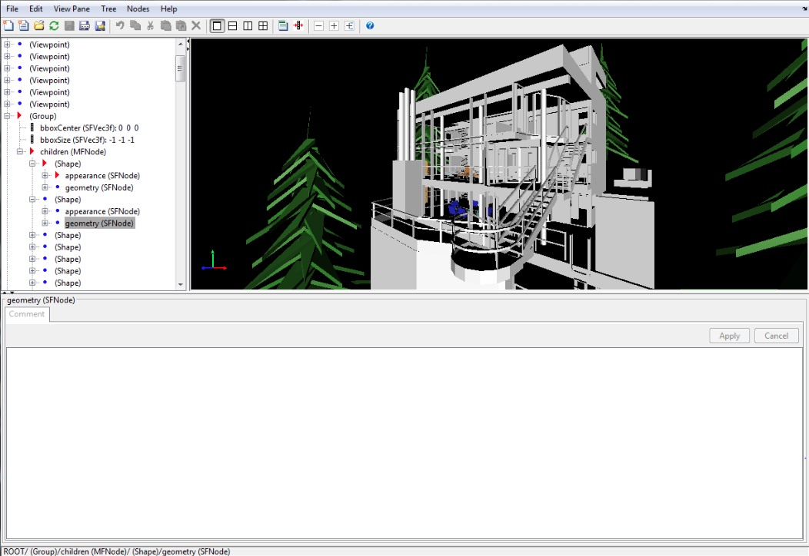
Examples of the problem ( Non-Anthropomorphic VE nodes )

Slide 63
Why did I pick on Simulink 3D animation – Oh why!

Slide 64
Overall Results for Web3D Interoperability
Results from lecture at Siggraph 2015 BOF meeting
Simulink 3D Animation will load VRML97 well
Simulink Models can be designed and used with VRML97 virtual environments and simulated sensors can be integrated with VRML97
Mathematica can visualize and then export VRML / X3d models [no import]

Slide 65
LABVIEW [IoT Anthropomorphism]
Simple Virtual Environments can be loaded but the VI’s that load VRML97 are not robust
Significant deficiencies
If a load is successful then the display has to be programed at a low level
Then, of course, the sensors and industrial controls have to be integrated at a very low level
Advantage: Real Time and very wide reaching

Slide 66

Labview SimVRML Load Results

Slide 67
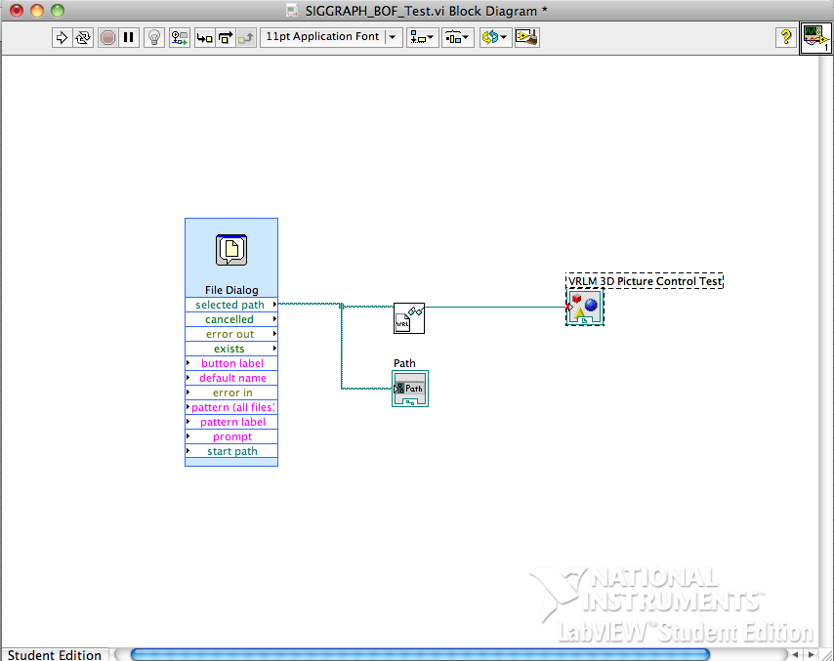

Slide 68
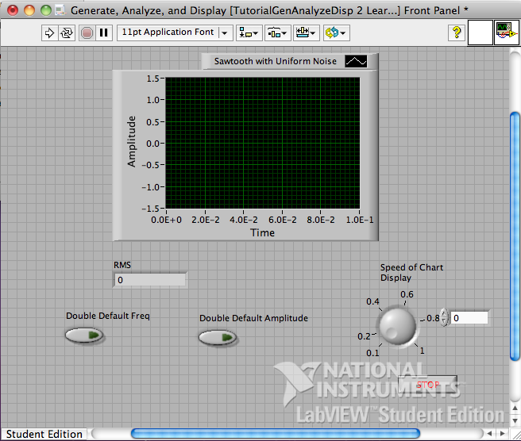

Slide 69
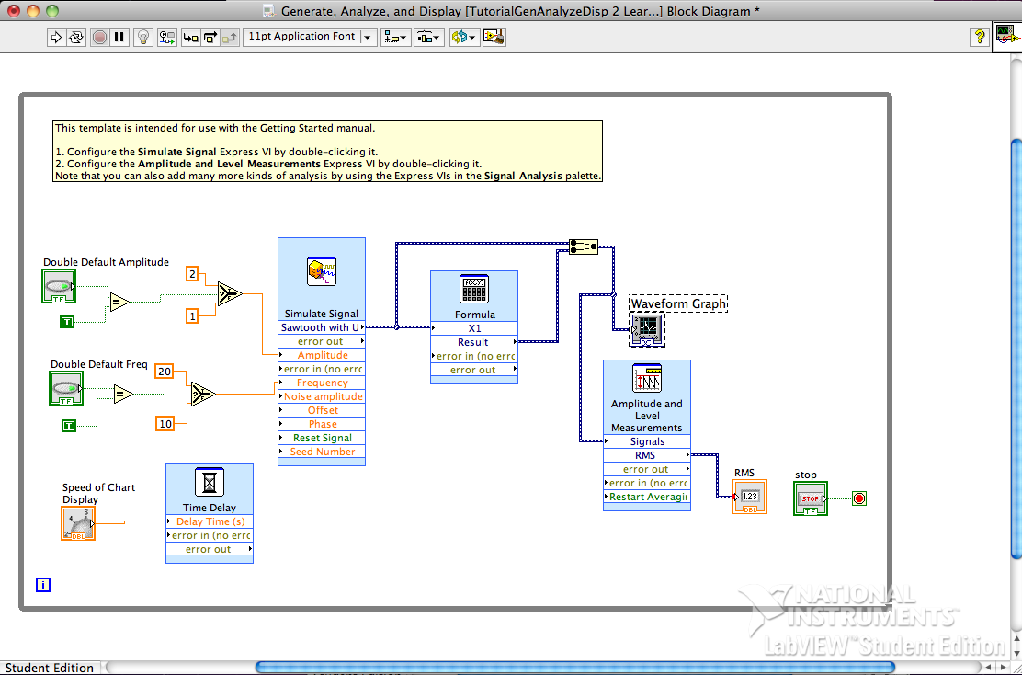

Slide 70
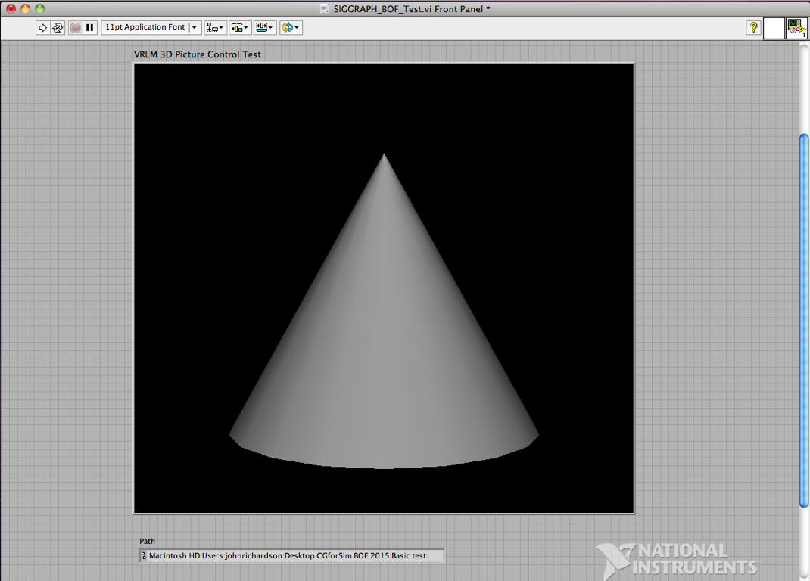

Slide 71
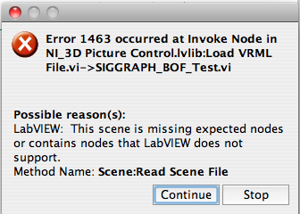

Slide 72
DAQ on MAC
Lego Mindstormes EV3
and
THE HARD WAY [build from scratch - low level parallel dataflow programming]
VRML / X3D file loader ( no error 1463…☺ )

Slide 73
Comments
Simulink 3D Animation is realistic today for simulations and VRML97
Labview is a work in progress
Did you notice that there is no X3D in this portion of the presentation!
Correct - Labview and MATLAB do not load X3D
Oops, Mathematica can visualize and export VRML / X3D [and STL] models
So you can 3-D print your Anthropomorphic tasks and behaviors ☺

